Slide 1
Software Testing

Slide 2
Software testing is a process of identifying the correctness of software by considering its all attributes (Reliability, Scalability, Portability, Re-usability, Usability) and evaluating the execution of software components to find the software bugs or errors or defects.
Software testing provides an independent view and objective of the software and gives surety of fitness of the software. It involves testing of all components under the required services to confirm that whether it is satisfying the specified requirements or not. The process is also providing the client with information about the quality of the software.
Testing is mandatory because it will be a dangerous situation if the software fails any of time due to lack of testing. So, without testing software cannot be deployed to the end user.

Slide 3
Testing is a group of techniques to determine the correctness of the application under the predefined script but, testing cannot find all the defect of application. The main intent of testing is to detect failures of the application so that failures can be discovered and corrected. It does not demonstrate that a product functions properly under all conditions but only that it is not working in some specific conditions.
Testing furnishes comparison that compares the behavior and state of software against mechanisms because the problem can be recognized by the mechanism. The mechanism may include past versions of the same specified product, comparable products, and interfaces of expected purpose, relevant standards, or other criteria but not limited up to these.

Slide 4
Testing includes an examination of code and also the execution of code in various environments, conditions as well as all the examining aspects of the code. In the current scenario of software development, a testing team may be separate from the development team so that Information derived from testing can be used to correct the process of software development.
The success of software depends upon acceptance of its targeted audience, easy graphical user interface, strong functionality load test, etc. For example, the audience of banking is totally different from the audience of a video game. Therefore, when an organization develops a software product, it can assess whether the software product will be beneficial to its purchasers and other audience.

Slide 5
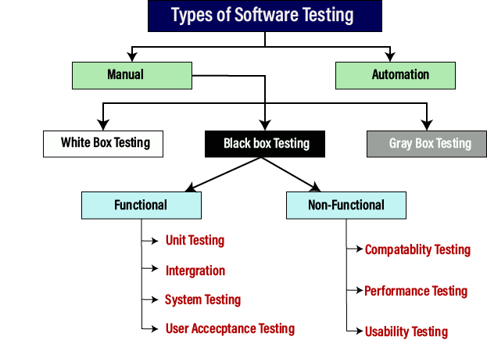

Slide 6
Manual testing
The process of checking the functionality of an application as per the customer needs without taking any help of automation tools is known as manual testing. While performing the manual testing on any application, we do not need any specific knowledge of any testing tool, rather than have a proper understanding of the product so we can easily prepare the test document.
Manual testing can be further divided into three types of testing, which are as follows:
White box testing
Black box testing
Gray box testing

Slide 7
Automation testing
Automation testing is a process of converting any manual test cases into the test scripts with the help of automation tools, or any programming language is known as automation testing. With the help of automation testing, we can enhance the speed of our test execution because here, we do not require any human efforts. We need to write a test script and execute those scripts.

Slide 8
Software Testing Principles
Software testing is a procedure of implementing software or the application to identify the defects or bugs. For testing an application or software, we need to follow some principles to make our product defects free, and that also helps the test engineers to test the software with their effort and time.

Slide 9
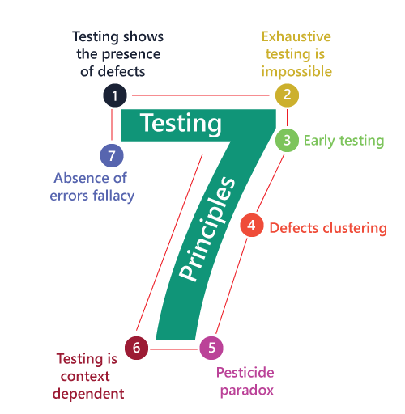

Slide 10
Testing shows the presence of defects
The test engineer will test the application to make sure that the application is bug or defects free. While doing testing, we can only identify that the application or software has any errors. The primary purpose of doing testing is to identify the numbers of unknown bugs with the help of various methods and testing techniques because the entire test should be traceable to the customer requirement, which means that to find any defects that might cause the product failure to meet the client's needs.
By doing testing on any application, we can decrease the number of bugs, which does not mean that the application is defect-free because sometimes the software seems to be bug-free while performing multiple types of testing on it. But at the time of deployment in the production server, if the end-user encounters those bugs which are not found in the testing process.

Slide 11
Exhaustive Testing is not possible
Sometimes it seems to be very hard to test all the modules and their features with effective and non- effective combinations of the inputs data throughout the actual testing process.
Hence, instead of performing the exhaustive testing as it takes boundless determinations and most of the hard work is unsuccessful. So we can complete this type of variations according to the importance of the modules because the product timelines will not permit us to perform such type of testing scenarios.

Slide 12
Early Testing
Here early testing means that all the testing activities should start in the early stages of the software development life cycle's requirement analysis stage to identify the defects because if we find the bugs at an early stage, it will be fixed in the initial stage itself, which may cost us very less as compared to those which are identified in the future phase of the testing process.
To perform testing, we will require the requirement specification documents; therefore, if the requirements are defined incorrectly, then it can be fixed directly rather than fixing them in another stage, which could be the development phase.

Slide 13
Defect clustering
The defect clustering defined that throughout the testing process, we can detect the numbers of bugs which are correlated to a small number of modules. We have various reasons for this, such as the modules could be complicated; the coding part may be complex, and so on.
These types of software or the application will follow the Pareto Principle, which states that we can identify that approx. Eighty percent of the complication is present in 20 percent of the modules. With the help of this, we can find the uncertain modules, but this method has its difficulties if the same tests are performing regularly, hence the same test will not able to identify the new defects.

Slide 14
Pesticide paradox
This principle defined that if we are executing the same set of test cases again and again over a particular time, then these kinds of the test will not be able to find the new bugs in the software or the application. To get over these pesticide paradoxes, it is very significant to review all the test cases frequently. And the new and different tests are necessary to be written for the implementation of multiple parts of the application or the software, which helps us to find more bugs.

Slide 15
Testing is context-dependent
Testing is a context-dependent principle states that we have multiple fields such as e-commerce websites, commercial websites, and so on are available in the market. There is a definite way to test the commercial site as well as the e-commerce websites because every application has its own needs, features, and functionality. To check this type of application, we will take the help of various kinds of testing, different technique, approaches, and multiple methods. Therefore, the testing depends on the context of the application.

Slide 16
Absence of errors fallacy
Once the application is completely tested and there are no bugs identified before the release, so we can say that the application is 99 percent bug-free. But there is the chance when the application is tested beside the incorrect requirements, identified the flaws, and fixed them on a given period would not help as testing is done on the wrong specification, which does not apply to the client's requirements. The absence of error fallacy means identifying and fixing the bugs would not help if the application is impractical and not able to accomplish the client's requirements and needs.

Slide 17
Levels of Testing
Testing levels are the procedure for finding the missing areas and avoiding overlapping and repetition between the development life cycle stages.
The levels of software testing involve the different methodologies, which can be used while we are performing the software testing.
In software testing, we have four different levels of testing, which are as discussed below:
Unit Testing
Integration Testing
System Testing
Acceptance Testing

Slide 18
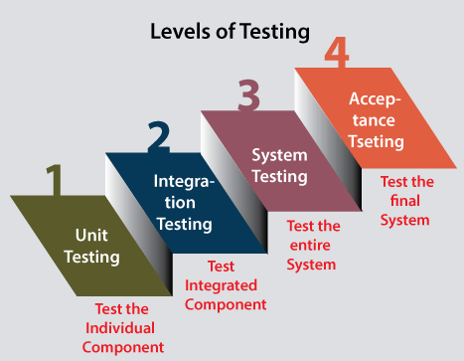

Slide 19
Level1: Unit Testing
Unit testing is the first level of software testing, which is used to test if software modules are satisfying the given requirement or not.
The first level of testing involves analyzing each unit or an individual component of the software application.
Unit testing is also the first level of functional testing. The primary purpose of executing unit testing is to validate unit components with their performance.
A unit component is an individual function or regulation of the application, or we can say that it is the smallest testable part of the software. The reason of performing the unit testing is to test the correctness of inaccessible code.
Unit testing will help the test engineer and developers in order to understand the base of code that makes them able to change defect causing code quickly. The developers implement the unit.

Slide 20
Level2: Integration Testing
The second level of software testing is the integration testing. The integration testing process comes after unit testing.
It is mainly used to test the data flow from one module or component to other modules.
In integration testing, the test engineer tests the units or separate components or modules of the software in a group.
The primary purpose of executing the integration testing is to identify the defects at the interaction between integrated components or units.
When each component or module works separately, we need to check the data flow between the dependent modules, and this process is known as integration testing.
We only go for the integration testing when the functional testing has been completed successfully on each application module.
In simple words, we can say that integration testing aims to evaluate the accuracy of communication among all the modules.

Slide 21
Level3: System Testing
The third level of software testing is system testing, which is used to test the software's functional and non-functional requirements.
It is end-to-end testing where the testing environment is parallel to the production environment. In the third level of software testing, we will test the application as a whole system.
To check the end-to-end flow of an application or the software as a user is known as System testing.
In system testing, we will go through all the necessary modules of an application and test if the end features or the end business works fine, and test the product as a complete system.
In simple words, we can say that System testing is a sequence of different types of tests to implement and examine the entire working of an integrated software computer system against requirements.

Slide 22
Level4: Acceptance Testing
The last and fourth level of software testing is acceptance testing, which is used to evaluate whether a specification or the requirements are met as per its delivery.
The software has passed through three testing levels (Unit Testing, Integration Testing, System Testing). Some minor errors can still be identified when the end-user uses the system in the actual scenario.
In simple words, we can say that Acceptance testing is the squeezing of all the testing processes that are previously done.
The acceptance testing is also known as User acceptance testing (UAT) and is done by the customer before accepting the final product.
Usually, UAT is done by the domain expert (customer) for their satisfaction and checks whether the application is working according to given business scenarios and real-time scenarios.

